Slide 1
Microsoft Movie Studio:Data Driven Strategy for movie creation

Slide 2

Microsoft Movie Studio
Data Driven Strategy for Movie creation
Group Members
1.Sylvia Wanyonyi- Sylvia.wanyonyi@moringaschool.com
2.Kelvin Obungu- Obungu-Kelvin.obungu@student.moringaschool.com
3.Samuel Okaro- Samuel.onyango2@student.moringaschool.com
4.Benedict Wambua- Benedict.wambua@student.moringaschool.com

Slide 3
Business Context
Microsoft is evaluating entry into the global film production industry.
The objective is to identify movie genres that maximize audience satisfaction and long-term brand value.
To develop a strategic genre approach to reduce risk and strengthens studio credibility.
Optimize Release & Distribution Strategy by tailoring content and release timing to regional preferences.
This analysis uses historical data

Slide 4
Business Questions
Which movies earned the most revenue?(Domestic and foreign)
Which genres consistently delivered higher audience satisfaction?
What ratings and revenue trends should guide Microsoft in movie creation?
Which studios created the best rated movies?

Slide 5
Data Sources
Three linked datasets were used for this analysis
IMDb – Basics– Genre classification and production year
IMDb –Ratings-Average audience ratings and vote counts
Bom movies– Domestic and international gross revenue
Notes:
[NEXT]
[NEXT]

Slide 6
Methodology overview
Datasets were cleaned and missing values handled
Datasets were merged using a unique movie identifier.(tconst)
Average ratings were calculated by genre and year.
Movies were grouped by genre and ratings to evaluate performance over time and audience reception.
Revenue and ratings were compared.
Trends were analyzed over time.

Slide 7
Key Finding 1 : Highest Revenue Movies
Sequel and cinematic movies dominate the highest revenue rankings, including Marvel, Star Wars, Harry Potter, and Disney properties.
Superhero and fantasy genres consistently generate the highest revenues, indicating strong global appeal.
Sequel movies outperform standalone films, benefiting from established fan bases and brand loyalty.
Family-friendly titles (e.g., Frozen, Beauty and the Beast) perform exceptionally well, showing broad demographic reach.
The revenue gap between top-performing films and average releases is significant, highlighting a “blockbuster-driven” revenue model.

Slide 8
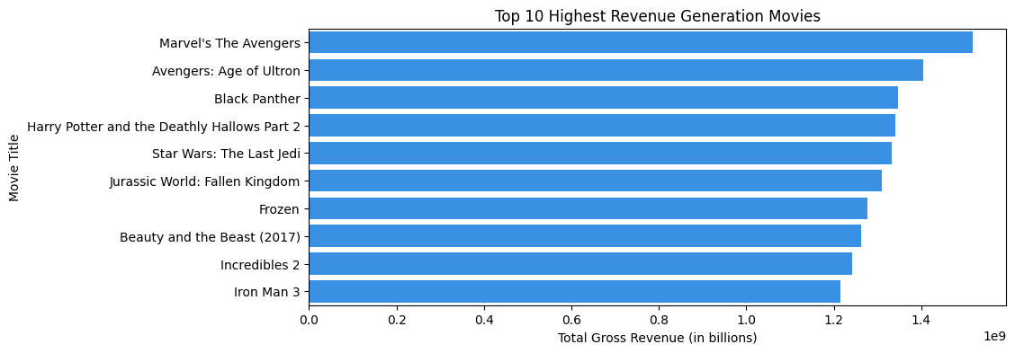
Top 10 Highest Revenue Generation movies

Slide 9
Key Finding 2: Ratings By Genres
Movies with higher audience engagement tend to receive higher ratings.
Popular, well-rated movies perform better commercially
Genres with comparatively low average audience ratings may reflect over saturation or weaker storylines

Slide 10
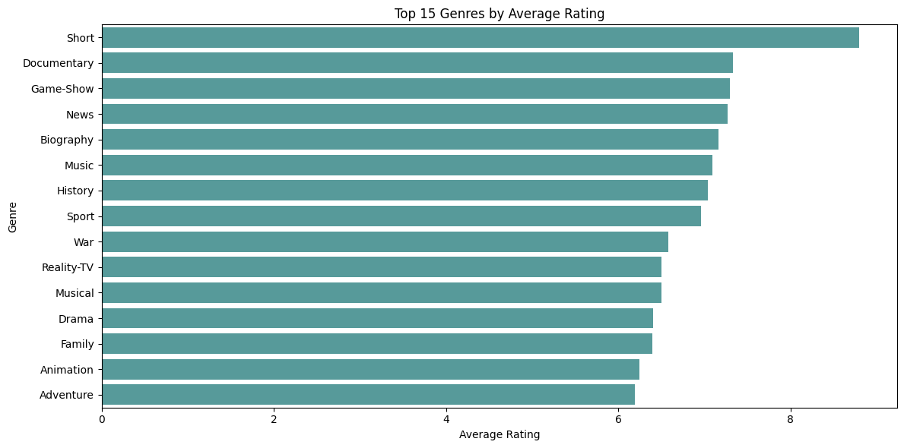
Movie Rating by Genres

Slide 11
Key Finding 3: Trends Over Time
Documentary, biography, and history genres show a steady upward trend, indicating growing audience appreciation over time
Action and adventure maintain stable ratings, suggesting consistent audience demand and predictable performance.
Drama and family genres show moderate improvement, reflecting steady but less aggressive growth.

Slide 12
Trends Over Time- Finding
Some genres (e.g., horror and certain niche genres) start from lower ratings but improve toward later years, signaling potential emerging opportunities.
Genres with declining or flat trends may require re-positioning, refreshed storytelling, or lower investment priority.

Slide 13
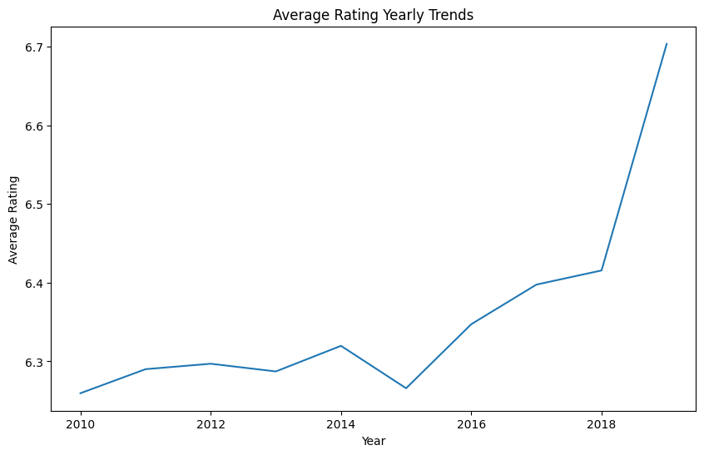
Average rating over time

Slide 14
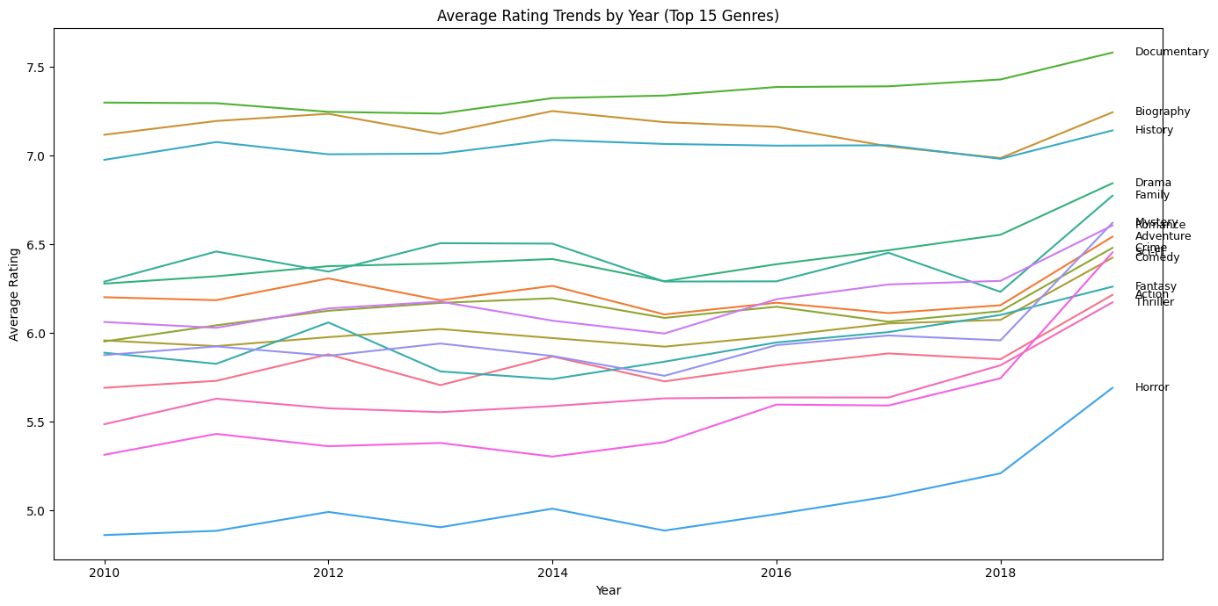
Average rating trends by Genres

Slide 15
Finding 4:Studio perfomance
P/DW and BV consistently rank among the top studios in both domestic and foreign box office revenue, indicating strong global market appeal. While WB performs strongly in the domestic market and HC leads internationally, the cross-market success .

Slide 16
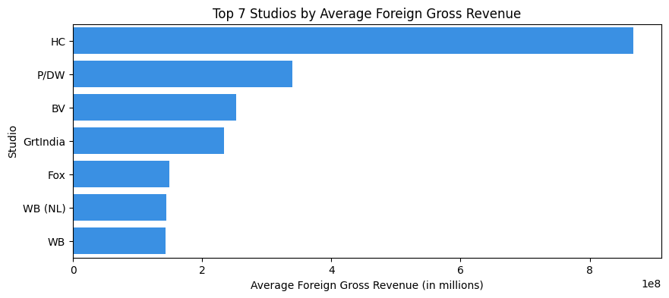
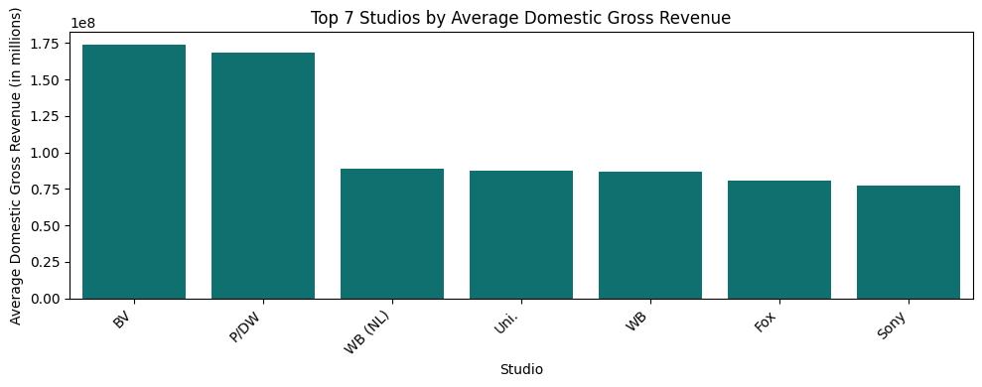
Foreign and Domestic gross revenue by Studio

Slide 17
Reccomendation: Genres
Prioritize revenue-driving genres for launch: Focus on Action, Adventure, and Sci-Fi, as these genres consistently lead global box office revenue and show strong international appeal.
Invest in high-rated genres to build reputation: Allocate resources to Short, Documentary, Game Show, News, and Biography to drive critical acclaim, audience satisfaction, and brand credibility.
Reevaluate underperforming genres: Conduct deeper analysis of Adventure, Animation, and Family to understand gaps in storytelling, marketing, or audience fit before scaling investment.
Adopt a balanced portfolio strategy: Maintain selective presence in popular commercial genres for box office or streaming traction, while prioritizing high-rated content to establish a strong studio identity

Slide 18
Reccommendation: Studios
Leverage top domestic performers (BV, P/DW, WB): Drive stable home-market revenue through sequels, franchises, and targeted domestic marketing.
01
Capitalize on strong foreign performers (HC, P/DW, BV): Expand international distribution, partnerships, and market-specific content strategies.
02
Align domestic and global strategies: Prioritize studios with strong performance in both markets (P/DW, BV) to reduce risk and maximize cross-market revenue.
03
Prioritize P/DW projects: Allocate greater resources to P/DW, leveraging its consistent domestic and international success to maximize total gross revenue and mitigate market volatility
04

Slide 19
Reccommendation:Ratings
Invest in high-visibility projects: Prioritize films likely to attract large audiences, as higher engagement correlates with better ratings.
Encourage audience participation: Promote campaigns or platforms that drive votes and reviews to boost perceived movie quality.
Analyze 2018 spike drivers: Investigate factors behind the sudden rise in 2018—genre, marketing, cast, or release strategy—and replicate successful elements in future releases.

Slide 20
Reccommendation:Revenue
Strengthen Domestic Revenue as a Safety Net
Leverage streaming and digital releases to expand domestic reach.
Implement targeted marketing campaigns to key domestic audiences.
Partner with other movie stakeholders to maximize home-market revenue.
Leverage Predictive Analysis for Foreign Revenue
Use data-driven forecasts to anticipate international market trends.
Develop a risk management plan based on projected foreign performance.
Optimize Release & Distribution Strategy
Tailor content, marketing, and release timing to regional preferences.
Align distribution channels and promotional efforts with target markets to maximize impact

Slide 21
General Reccommendation
Leverage Microsoft’s Ecosystem
By integrating film content with Xbox, Game Pass, Azure, AI, and streaming platforms to maximize cross-platform monetization and audience reach.

Slide 22
Conclusion
To position Microsoft’s new movie studio for success, a data-driven, balanced approach is recommended. Strengthening domestic revenue through streaming, targeted marketing, and strategic partnerships provides a stable base, while predictive analysis of foreign markets enables proactive risk management. Content strategy should focus on high-performing and high-rated genres—Action, Adventure, Sci-Fi, Short, Documentary, Game Show, News, and Biography—while carefully analyzing underperforming genres before committing significant resources.
Optimized release and distribution strategies tailored to regional preferences, combined with initiatives to boost audience engagement and voting, will maximize ratings, viewership, and cross-market revenue. Leveraging top-performing studios such as P/DW and BV ensures strong domestic and international appeal, supporting sustainable growth, reputation-building, and long-term success for the new studio.

